Slide 1

The Impact Of Subprime Lending On The 2009 Real Estate Market
Student’s Name:
Institution:
Course:
Instructor:
Date:

Slide 2
Introduction
Subprime mortgage lending grew from 2003 (Hellwig, 2009).
26% of US home loans were subprime in 2006 (Fligstein & Goldstein, 2011).
Subprime mortgages bundled into assets, sold to investors as MBS.
Rise in interest rates led to defaults,
impacting mortgage-backed securities,
causing massive losses and financial turmoil in 2007
How did this affect real estate market in 2009?.
Notes:
The Impact of Subprime Lending on the 2009 Real Estate Market
Widespread real estate losses, foreclosures, plummeting stock, and a worldwide economic downturn marked the 2008 financial crisis. Subprime mortgage lending was central to this crisis (Hellwig, 2009). At the peak of the housing bubble in 2006, approximately 26% of all US home loans were classified as subprime (Fligstein & Goldstein, 2011). These mortgages were bundled and used as assets to back securities sold to other investors. When interest rates increased, the mortgage repayment defaults affected the value of mortgage-backed securities and credit default swaps. In 2007, the involved financial institutions lost trillions of dollars in equity and faced credit freezes, massive liquidation risks, lawsuits, and bankruptcy. This research explores subprime lending and how it affected the real estate markets during the recession.

Slide 3
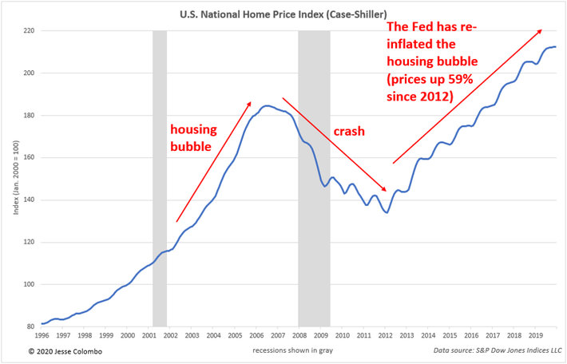
Housing Market Bubble
US Housing Boom (Early 2000s)
Unprecedented surge in the housing market (Case & Quigley, 2008).
Factors Driving Boom
Low interest rates.
Speculative investing.
Relaxed lending standards.
Post-9/11 Federal Reserve Response
Lowered interest rates to enhance capital access (McCarthy & Peach, 2005).
Notes:
Housing Market Bubble
The United States housing market witnessed an unprecedented boom and growth in the early 2000s (Case & Quigley, 2008). Many factors, such as low interest rates, speculative investing, and relaxed lending standards, fueled this boom. After 9/11, the Federal Reserve responded by lowering the interest rates to boost access to capital for rebuilding, investment, and growth (McCarthy & Peach, 2005). At the same time, the dot-com bust created an environment ripe for speculations of growth and financial success. As a result, many citizens were eager to borrow money, especially for building homes, formally known as a mortgage (Keys et al., 2012). With the high mortgage demand, financial institutions and lenders were eager to capitalize on this opportunity (Kaplan et al., 2020). The solution was to offer mortgages to borrowers with weak credit histories and a high risk of default; this is also referred to as subprime mortgages.
The situation was worsened by unreliable credit rating agencies and analysts who cleared borrowers previously deemed ineligible for mortgages. According to Haughwout et al. (2012), unscrupulous credit rating agencies liaised with financial institutions and stock brokers to clear credit unworthy borrowers. At the same time, contractors and lenders collaborated in overpricing houses and mortgages respectively (Haughwout et al., 2012). The Figure 1 below shows the consistent rise in house prices until 2006 when a drastic fall began. The financial misconduct by these different stakeholders influenced the high demand for mortgages and perceptions about home ownership and real estate investments (Jones & Sirmans, 2019). The financial institutions were most optimistic about the hefty returns on investments, to the extent that some entities falsified documents for mortgage applications (Kaplan et al., 2020). Some lenders inflated pay slips to qualify some borrowers for the highly-priced mortgage.

Slide 4
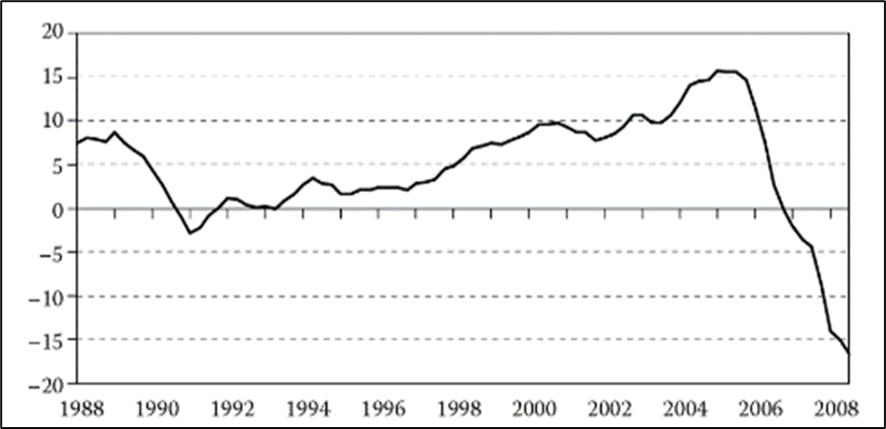
Housing Market Bubble
Subprime Mortgages
High demand led to the offering of subprime mortgages to weak credit borrowers (Kaplan et al., 2020).
Risk Factors in Housing Boom
Unreliable credit rating agencies.
Financial misconduct.
Adjustable interest rates.
Overpriced mortgage and house values
Figure 1: The annual home price index data in the United States
Notes:
The figure above shows a steady rise in house prices between 2004 and 2006, stimulated by the available subprime mortgages and demand for single-family homeownership. According to the California Association of Realtors (CAR), many households could qualify for mortgages from different lenders (Kahn & Kay, 2019). Affordability varied widely across the state, with the San Francisco Bay Area consistently having the lowest levels (21% in 2001 and 11% in 2007). Conversely, the Sacramento area initially matched the US affordability level in 2000 at 53% but declined to a low of 21% in 2005 (Duca et al., 2019).
The real estate market peaked with massive construction projects, mortgage borrowing and lending, and home affordability (Baker, 2008). However, while most American citizens scrambled to own homes, the mortgages had adjustable interest rates (Fahey & Duffy, 2008). The boom in the real estate market was controllable by adjusting the interest rates to regulate access to credit, mortgage, and asset-backed securities. From 2004 to 2006, the Federal Reserve responded to the booming mortgage market by raising interest rates from 1% to 5.25%. This monetary policy shift aimed to cool down the housing market and curb speculative behavior (Kaplan et al., 2020). The interest rate increases implied that the subprime mortgage interests could be adjusted accordingly. Mortgage lenders quickly changed the value of mortgages, particularly those with adjustable-rate and interest-only loans. As a result, many homeowners faced an increase in higher payments, while other consumers were discouraged from taking mortgages.

Slide 5
Mortgage-Backed Securities (MBS) and Credit Default Swaps
MBS Introduction
Subprime lending impact extended to MBS market (Fligstein & Goldstein, 2011).
MBS bundled mortgages, sold to investors, creating an illusion of safety (Plouvier, 2017).
Risks of MBS
AAA ratings for risky subprime-backed MBS (Martin, 2009).
Lucrative but introduced complexity and opacity (Van Order, 2018).
Notes:
A study by Fligstein and Goldstein (2011) argued that the scope of subprime lending and its impacts on real estate also entails the mortgage-backed securities (MBS) market. The securitization of subprime mortgages catalyzed disaster and the ripple effects on other stocks and the overall economic state (Fligstein & Goldstein, 2011). The MBS were financial products created by bundling individual mortgages into investment packages, then sold to investors and other financial institutions (Plouvier, 2017). The lenders packaged subprime mortgages into MBS, providing an illusion of safety and attractive returns (Mayer et al., 2009). These securities were often rated by unscrupulous credit rating agencies, with many receiving AAA ratings despite being backed by risky subprime loans (Martin, 2009). MBS was a lucrative investment for other financial institutions and private investors who had missed out on the booming mortgage business (Jaffee, 2008). As such, the subprime mortgage lenders created MBS to meet this demand for high-yield investments, especially from other financial institutions like hedge funds, banks, and insurance companies.
Increased liquidity and diversification were pivotal advantages associated with Mortgage-Backed Securities (MBS). The bundling of individual mortgages into tradable securities not only enhanced the liquidity of the mortgage market but also allowed banks to liberate capital previously tied up in mortgages, fostering increased lending (Plouvier, 2017). Moreover, MBS provided investors a vehicle for diversified exposure to the housing market without directly managing individual loans (Fligstein & Goldstein, 2011). This diversification spreads risk across various mortgage-backed assets, reducing the impact of the default of a single mortgage on the overall investment (Duca et al., 2019). The risk-spreading mechanism inherent in MBS aimed to enhance the stability of the financial system by avoiding the concentration of risk within a single institution or investor (Mizen, 2008). However, these advantages of MBS also brought about new risks.
According to Van Order (2018), the complex structure of MBS introduced opacity into the financial system, making it challenging for investors to comprehend the underlying risks of bundled mortgages entirely. This lack of transparency hindered accurate risk assessment and decision-making among lenders, borrowers, and investors (Mizen, 2008). Additionally, the widespread use of MBS introduced a moral hazard, as the diffusion of risk across the financial system influenced lenders to become less diligent in evaluating borrower creditworthiness (Ospina & Uhlig, 2018). For instance, subprime mortgage lenders and MBS buyers assumed risk was adequately mitigated through securitization and interconnectedness (Jaffee, 2008). Furthermore, the correlation between mortgages within an MBS posed a potential risk. While diversification aimed to spread risk across various mortgages, a simultaneous default of mortgages within an MBS could lead to substantial losses for investors, which is precisely what happened in the 2007 Great Recession (Duca, 2013).

Slide 6
Mortgage-Backed Securities (MBS) and Credit Default Swaps
Challenges and Risks
Lack of transparency hindered risk assessment (Mizen, 2008).
Moral hazard and correlated defaults contributed to 2007 recession (Duca, 2013).
Credit Default Swaps (CDS)
Investors sought security through CDS, acting as insurance (Lazukićová, 2019).
CDS introduced complexity and interconnectedness (Mizen, 2008).
Notes:
The underlying risks associated with these MBSs were eminent, and investors in MBS sought security through credit default swaps (CDS) (Duca, 2013). CDS were financial instruments that acted as insurance contracts against the default of a borrower, protecting investors in case the underlying asset (mortgage) failed. Lazukićová (2019) simplifies CDS as insurance contracts that other financial institutions sell to buyers of MBS to safeguard them against the risk of default by mortgage borrowers. These derivatives allowed investors to hedge against the risk of default, but they also introduced a layer of complexity and interconnectedness in the financial system (Mizen, 2008). This interconnected nature was so complex that banks, hedge funds, investment firms, insurers, and other financial institutions acted as sellers and buyers of mortgage MBS and CDOs (Kroll, 2013). All these players relied on one illusion that mortgage owners would repay their overpriced loans, hence hefty returns for the lender.
The overconnected nature of the financial system in 2006 was a hallmark of the crisis (Hellwig, 2009). Unlike traditional insurance, CDS allows investors to speculate on the risk of mortgage defaults without holding the underlying mortgage-backed securities (MBS) (Lazukićová, 2019). The free trade of CDS in a secondary market created an environment where financial instruments and bets on mortgage defaults were detached from the fundamental realities of the housing market. In essence, the investors, hedge funds, and financial institutions bet on the likelihood of mortgage defaults without a direct connection to the actual performance of the mortgages (Peterson, 2009). This decoupling from the underlying assets created an environment where the market for CDS became more driven by speculation, market sentiment, and the pursuit of short-term profits. Ospina and Uhlig (2018) assert that free trading of CDS ignored the critical assessment of the creditworthiness of mortgage borrowers and the health of the real estate market.

Slide 7
Mortgage-Backed Securities (MBS) and Credit Default Swaps
Complexity of CDS Market
Overconnected financial system in 2006 was a crisis hallmark (Hellwig, 2009).
CDS detached from mortgage performance, driven by speculation (Peterson, 2009).
Speculative Environment and Risky Practices
Financial players, including subprime lenders, felt insulated by offloading risk through CDS (Lazukićová, 2019).
Speculative CDS trading contributed to excessive risk-taking and crisis escalation (Jaffee, 2008).
Notes:
A study by Lazukićová (2019) also asserts that subprime mortgage lenders felt insulated by the ability to offload risk through CDS. The financial incentives shifted towards making more loans, including subprime mortgages, as the risk associated with these loans could be transferred to MBS buyers and CDS sellers (Ospina & Uhlig, 2018). The speculative nature of the CDS market and the interconnectedness of financial institutions meant that a default in one part of the market could trigger a chain reaction of losses across various entities (Kroll, 2013). In essence, the detachment of CDS trading from the underlying fundamentals of the housing market contributed to a climate of excessive risk-taking, as financial players sought short-term gains without adequately considering the long-term consequences (Jaffee, 2008). This speculative environment and risky lending practices played a pivotal role in escalating the subprime mortgage crisis and the subsequent global financial downturn.

Slide 8
Defaults on Subprime Mortgages Repayment
Magnitude of Subprime Issuance (2006)
Financial institutions issued $600 billion in subprime mortgages, constituting 23.4% of all US mortgages (Ospina & Uhlig, 2018).
Federal Reserve raised interest rates, impacting adjustable-rate mortgages (ARMs) and interest-only loans (Mayer et al., 2009).
Rapid Default Onset (2007)
Massive repayment defaults began as homeowners struggled with increased interest payments (Mayer et al., 2019).
Overpriced houses, high living costs, and declining incomes led to a surge in defaults (Schelkle, 2018).
Notes:
As of 2006, financial institutions had issued about $600 billion in subprime mortgages, nearly 23.4% of all mortgages in the US (Ospina & Uhlig, 2018). This is when the Federal Reserve raised the interest rates and adjusted the cost of payments for adjustable-rate mortgages (ARMs) and interest-only loans (Mayer et al., 2009). According to Mayer et al. (2019), the massive repayment default on mortgage loans began when many lenders could not pay the increased interest. Some homeowners decried the high maintenance expenses on the houses since they were primarily overpriced, had a high cost of living, and had declining incomes (Schelkle, 2018). Such a massive default rate implied that subprime mortgage lenders could not recoup their investments and subsequently pay the MBS investors (Bajari et al., 2008). Leading lenders that had once prospered by aggressively issuing high-risk loans, such as New Century Financial and Countrywide Financial, faced high delinquency rates in 2007.
On April 2, 2007, the New Century filed for bankruptcy under Chapter 11 after reporting a staggering $74 billion in defaulted mortgage loans (Jones & Sirmans, 2019). Other financial institutions that filed for bankruptcy include Mortgage Lenders Network USA Inc., with $4.9 billion loans defaulted, Silver State Mortgage, $0.5 billion, Sunset Direct Lending LLC, SouthStar Funding LLC, and American Home Mortgage Investment, among many others (Schelkle, 2018). Moreover, many other subprime mortgage lenders were sold, closed, or stopped giving loans indefinitely. Lenders like Sebring Capital Partners LP, Secured Funding Corp., Deep Green Financial Inc., and Fremont Investment & Loan were sold. Most of these sales were last-minute acquisitions by Bank of America and other more vital institutions that aimed to salvage the situation (Cunningham et al., 2021). By July 2008, 20% of subprime mortgages were delinquent, with 29% of ARMs seriously outstanding, as shown in the Figure 2 below (Ospina & Uhlig, 2018).

Slide 9
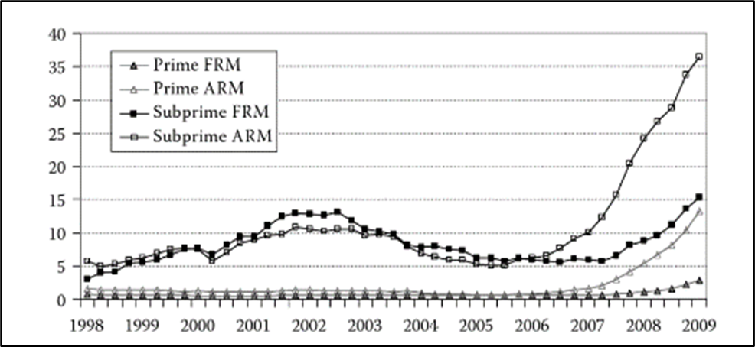
Defaults on Subprime Mortgages Repayment
Bankruptcies and Delinquencies
New Century Financial filed for bankruptcy in 2007, reporting $74 billion debts (Jones & Sirmans, 2019).
Numerous other lenders filed for bankruptcy
20% of subprime mortgages were delinquent by July 2008 (Ospina & Uhlig, 2018).
Foreclosures and Market Impact
Widespread foreclosures began in California, and spread nationwide (Peterson, 2009).
Foreclosures led to a 30% drop in property value, and millions losing their homes (Glaeser & Gyourko, 2018).
Figure 2: Percentage of single-family mortgage delinquency (Mortgage Bankers Association 2011)
Notes:
As the default rate and delinquency increased rapidly, lenders sought varied interventions and risk management measures (Schelkle, 2018). The obvious response was the widespread foreclosures that began in California, Nevada, and Florida and spread countrywide. According to Peterson (2009), foreclosure is a financial strategy for reclaiming the ownership of real estate properties in case the borrower defaults on mortgage repayment. Foreclosures meant that financial institutions had empty houses whose value had dropped by 30%, and there was no buyer (Jones & Sirmans, 2019). Many lending institutions opted for foreclosures on the houses of defaulters, and millions of single-family homeowners lost their properties (Glaeser & Gyourko, 2018).
However, as asserted by Holmes et al. (2021), foreclosures were ineffective in recovering the value of mortgages since the real estate market was already weakened. The lenders could not find new buyers for the initially overpriced properties, so they could not recover the return on these mortgages (Adelino et al., 2018; Holmes et al., 2021). Figure 3 below shows the high rate of foreclosures, which skyrocketed in 2007 as subprime mortgage lenders reclaimed houses from defaulters

Slide 10
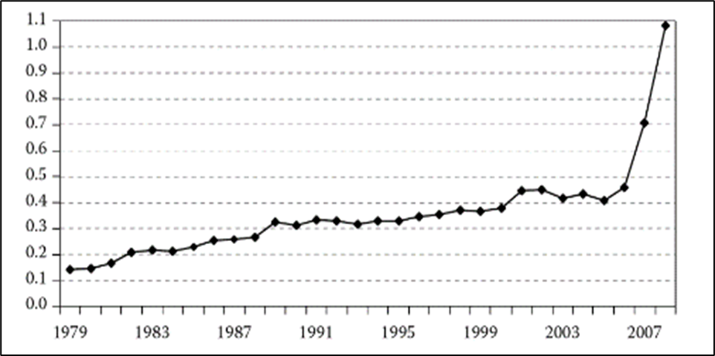
Defaults on Subprime Mortgages Repayment
Ineffectiveness of Foreclosures
Foreclosures failed to recover mortgage values (Holmes et al., 2021).
Figure 3 illustrates the surge in foreclosures in 2007.
Market Impact: Construction and Sales
Foreclosures impacted construction and sales
Stagnating the real estate market (Cunningham et al., 2021).
US foreclosures reached $2.8 million in 2010
A 91% drop in housing constructions from 2005 to 2009 (Holmes et al., 2021).
Figure 3: Rate of foreclosures on all mortgages
Notes:
Foreclosures affected the real estate market by stagnating construction, sales, and financial plans. This was a period when mortgage lenders reclaimed millions of empty homes. During the 2008 financial crisis, US foreclosures skyrocketed to $2.8 million in 2010, 1.5% of all occupied housing units (Holmes et al., 2021). Similarly, the foreclosed homes flooding the market caused a dramatic decline in new construction activity. Housing constructions plunged from 2.5 million units in 2005 to 470,000 units in 2009, a 91% decrease (Cunningham et al., 2021). Therefore, the mortgage craze ended, repayment challenges started, and the real estate bubble busted.

Slide 11
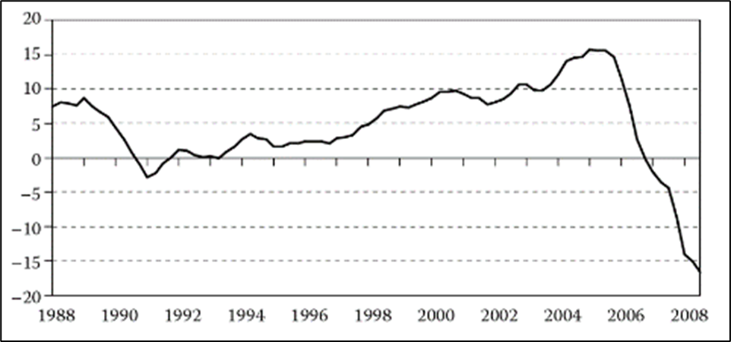
Real Estate Bubble Burst and Financial Losses
Bursting of Housing Bubble (2006-2007)
Existing homeowners unable to afford monthly payments (Sornette & Woodard, 2010).
"Get rich quick" mentality deteriorated among lenders, investors, and contractors.
Burst triggered by rising interest rates, mortgage defaults, and foreclosures (Aziz, 2012).
Financial Losses and Market Collapse
Real estate market collapse with negative equity by 2008 (Figure 4).
Severe financial losses (Baker, 2008).
Figure 4: The percentage annual growth rate of US home price index
Notes:
By 2006, the bursting of this housing bubble began when existing homeowners could neither afford monthly interest nor find a buyer for the property (Sornette & Woodard, 2010). The unrealistic optimism created by years of consistent home price appreciation had ended, and the "get rich quick" mentality deteriorated among lenders, investors, and contractors. In 2007, the housing bubble finally burst, triggered by the events that started with the rise in interest rates, followed by defaults on mortgages and foreclosures (Aziz, 2012). Figure 4 below shows the change in housing prices over the years in the United States - a sudden fall in prices started in 2006 until it hit negative equity by 2007. In 2008, the housing price index had fallen below -15%. This implied that a surplus of cheap real estate properties was always tied to overpriced mortgage loans, and there was no demand. The real estate market collapsed in the United States and affected millions of homeowners, contractors, lenders, and families

Slide 12
Real Estate Bubble Burst and Financial Losses
Impact on Mortgage Lenders
Negative equity, liquidity risks (Sornette & Woodard, 2010).
Collapse of mortgage-backed securities (MBS) and collateralized debt obligations (CDOs).
Losses for MBS Investors
Defaulted mortgages (Moretti, 2019).
MBS investors, including major banks, investment funds, pension funds, and insurance companies, faced substantial losses (Albanesi, 2018).
CDS Brokers and Interconnected Risks
New Century Financial and Countrywide Financial bankruptcy.
Interconnectedness within CDOs amplified impact of defaults, (Fabozzi & Xiao, 2019).
Notes:
The financial losses from the real estate bubble burst were severe and affected both local and international economies, investors, and families (Baker, 2008). The mortgage lenders were the first to experience negative equity amidst substantial liquidity risks. Sornette and Woodard (2010) state that the rise of interest rates started the domino effect that led to mortgage defaults and then the loss of mortgage-backed securities. By 2008, the real estate market had collapsed to negative equity, with mortgage lenders facing a liquidity crisis, lawsuits, and a lack of credit (Albanesi, 2018). As the default on subprime mortgages skyrocketed, the securities entangled in these mortgages collapsed. The mortgage-backed securities (MBS) and collateralized debt obligations (CDOs) that were initially meant to spread risks finally did their job.
As homeowners defaulted on their mortgage payments, the value of the mortgage-backed securities tied to these loans deteriorated rapidly (Moretti, 2019). Investors who held these securities experienced substantial losses as the once-highly-rated MBS lost its value, revealing the underlying vulnerability of the financial instruments. Most MBS investors were directly affected by the default crisis despite having no ownership or control over the mortgages. These investors included commercial banks like Citigroup, Bank of America, and Wells Fargo; investment funds; pension funds like California Public Employees' Retirement System (CalPERS) and the New York State Common Retirement Fund; insurance companies; and foreign investors (Albanesi, 2018).
When New Century Financial and Countrywide Financial filed for bankruptcy, the MBS investors sought immediate compensation from the credit default swap (CDS) brokers. The interconnectedness of different debt obligations within CDOs meant that the impact of defaults in one sector reverberated throughout the entire structure (Fabozzi & Xiao, 2019). The complexity of these instruments and the opaqueness surrounding the underlying assets made it difficult for investors to assess the risks accurately. For instance, players like Citigroup and Wells Fargo were active investors in MBS and CDS sellers. A study by Giudici et al. (2020) argued that the interconnectivity in the MBS-CDS business was so complex and opaque that financial institutions were chained together and open to the same risks. Investors of MBS had billions of worthless securities, massive liquidity risks, debt defaults, and losses of billions of dollars.

Slide 13
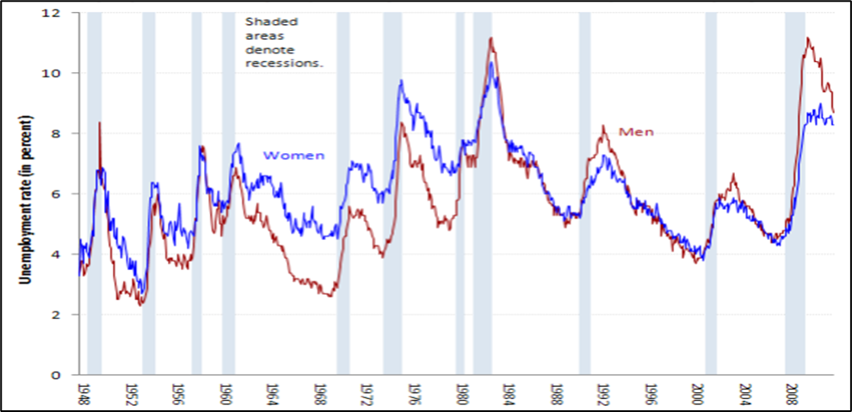
Real Estate Bubble Burst and Financial Losses
Bear Stearns and Lehman Brothers Collapse (2008)
Bear Stearns collapsed (Moretti, 2019).
Lehman Brothers filed for bankruptcy with $613 billion in debt (Guo, 2023).
Global Financial Crisis and Economic Fallout
Interconnectedness led to severe liquidity crises, frozen credit markets, and a fast decline in global stock markets.
S&P 500 index fell by 57% (2007-2009)
Millions lost their homes, unemployment doubled to 10% by June 2009
Figure 5: Unemployment rate in the United States (Bureau of Labor Statistics, 2012).
Notes:
In March 2008, Bear Stearns, a prominent investment bank, faced a rapid and unexpected collapse. The firm, heavily exposed to mortgage-backed securities and struggling with liquidity issues, was on the brink of insolvency (Guo, 2023). In a historic move, the US government orchestrated a bailout, facilitating JPMorgan Chase's acquisition of Bear Stearns at a substantially reduced price (Moretti, 2019). Despite the government bailout and acquisition, the Bear Stearns crisis had massive job losses that highlighted the risks. On September 25, 2008, Lehman Brothers filed for bankruptcy with $613 billion in debt; this was the most significant event in the 2007 Great Recession (Guo, 2023). Lehman Brothers was one of the oldest and largest investment banks, with billions invested in MBS and CDS. When it collapsed and laid off thousands of workers, it sent shockwaves through global financial markets, leading to panic and loss of confidence in the stock markets.
The interconnectedness of financial institutions meant that all other entities connected to Lehman's assets were under financial distress. These financial institutions faced severe liquidity crises, credit markets froze, and access capital was severed. The lack of confidence in the financial system led to a fast decline in stock markets worldwide (Yunus, 2018). All global financial institutions and stock trading was greatly affected as the S&P 500 index fell by 57% between 2007 and 2009. Within weeks, millions of people had lost their homes, savings, and jobs as unemployment doubled to nearly 7.5 million, a 10% high by June 2009, as shown in Figure 5 below (Bureau of Labor Statistics, 2012).

Slide 14
Great Recession and Housing Crisis
Global Financial Impact
US households lost nearly $16 trillion in assets; a 75% real estate investment loss.
S&P 500 index plunged by 53%, over $8 trillion in US household stock market capital (Guo, 2023).
Federal Reserve estimated a total household assets loss of $19.2 trillion (2007-2011) (Glaeser & Gyourko, 2018).
International Economic Slowdown
Economic distress spread globally, affecting China, India, the UK, Indonesia, and other countries.
China's GDP growth plummeted to 9.4% in 2009.
India and the UK experienced financial crises, with GDPs falling to 6.7% and 6.2%, respectively (Kim et al., 2019).
Iceland's government collapsed, Latvia's GDP contracted by over 25%, and Spain, Greece, Ireland, Italy, and Portugal faced sovereign debt crises and mass layoffs (Villarroya Gargallo, 2018).
Notes:
The financial distress in US stock markets soon spread to international institutions. US households had lost nearly $16 trillion of their assets, with over a quarter losing at least 75% of their real estate investment. During 2007-2009, the S&P 500 index, a key measure of US stock prices, plunged by 53%, a loss of over $8 trillion in US household stock market capital (Guo, 2023). The Federal Reserve estimates a household assets loss of $19.2 trillion between 2007 and 2011; this included losses in stocks, real estate, and other financial assets (Glaeser & Gyourko, 2018). These severe economic slowdowns spread to other countries, including China, India, the UK, and Indonesia. China’s GDP growth plummeted to 9.4% in 2009, the lowest rate since 1990 (Bianchi et al., 2018). This was characterized by a decline in exports to the US, leading to widespread factory closures and job losses.
India and the United Kingdom faced similar financial crises, with their GDPs falling to 6.7% and 6.2%, respectively. These economies were integral to the global export and stock markets and the global real estate industry (Kim et al., 2019). The government of Iceland collapsed, and the three largest banks were nationalized (Villarroya Gargallo, 2018). The GDP of Latvia contracted by over 25% in 2008–09, accompanied by a spike in unemployment, reaching 22% during the same period. Meanwhile, Spain, Greece, Ireland, Italy, and Portugal grappled with sovereign debt crises, credit freezes, and mass layoffs.

Slide 15
Great Recession and Housing Crisis
Intensification of Housing Crisis (2008)
Subprime mortgages contributed to the housing crisis (Bajari et al., 2008).
Risky subprime mortgages, lax regulations, and irresponsible lending practices drove the crisis.
Surplus of homes in the real estate market, but millions faced homelessness.
Existing homes for sale in the US almost doubled from 4 million to over 7 million units (Glaeser & Gyourko, 2018).
Impact on Homelessness
Between 2007 and 2010, the estimated number of homeless people in the US increased by about 20%, from 640,000 to 780,000.
Notes:
The housing crisis, unfolding for years, intensified in 2008 with a surge in mass foreclosures. According to Bajari et al. (2008), subprime mortgages contributed to the housing crisis, where millions of Americans lost their homes amidst economic hardships. The widespread issuance of risky subprime mortgages, lax regulations, and irresponsible lending practices primarily drove the crisis. The real estate market had a surplus of homes, but Americans were facing massive homelessness. Between 2007 and 2010, the number of existing homes for sale in the US almost doubled, rising from 4 million to over 7 million units (Glaeser & Gyourko, 2018). The oversupply of homes, coupled with a decrease in demand, resulted in an unfavorable real estate market. The estimated number of homeless people in the US increased by about 20%, from 640,000 to 780,000.

Slide 16
Real Estate Market Recovery Post-Recession
Government Intervention and TARP
Troubled Asset Relief Program (TARP) signed into law in October 2008 (Ncube & Hausken, 2019; Massad & Kashkari, 2018).
Affordable and Rural Housing Recovery
Making Home Affordable program (Schwartz, 2012).
Demand from first-time buyers in the affordable housing segment;
rural housing prices declined by only 7% between 2006 and 2012 (Federal Reserve Bank study).
Notes:
In response to the escalating crisis, the US government initiated measures to stabilize the financial system (Harvey, 2018). In October 2008, President George W. Bush signed into law the Troubled Asset Relief Program (TARP) (Ncube & Hausken, 2019). TARP aimed to provide financial institutions with capital injections to stabilize their balance sheets and restore confidence in the financial markets (Ncube & Hausken, 2019; Massad & Kashkari, 2018). The program authorized the purchase of distressed assets from financial institutions, injecting much-needed liquidity into the system. According to Massad and Kashkari (2018), TARP was a controversial measure but played a crucial role in preventing a total collapse of the financial system. The government's intervention, coupled with coordinated efforts from central banks globally, helped mitigate the immediate impact of the crisis.
The real estate recovery post-recession was substantial in the affordable housing and rural housing sectors. The affordable housing segment was favored by the Making Home Affordable program of the government and demand from first-time buyers seeking accessible options (Schwartz, 2012). According to the National Association of Realtors, the median sales price for existing single-family homes under $250,000 increased by 1.2% from 2007 to 2010, while higher-priced segments saw significant declines. Lower housing costs and a flight to affordable living spurred demand in rural areas. A 2014 study by the Federal Reserve Bank found that rural housing prices declined by only 7% between 2006 and 2012, compared to a 23% decline in urban areas.

Slide 17
Real Estate Market Recovery Post-Recession
Congressional Legislation: Dodd-Frank
Dodd-Frank legislation,
Financial Stability Oversight Council,
Volcker Rule (Hamburger, 2011).
Mortgage Act and Consumer Financial Protection Act (CFPA)
Mortgage Act within Dodd-Frank introduced new standards (Schorgl, 2018).
Consumer Financial Protection Act established the Consumer Financial Protection Bureau (CFPB) (Harvey, 2018; Zywicki, 2013).
Ongoing Recovery and Flourishing Real Estate Market
Stringent regulatory measures, ethical financial practices.
Notes:
Congress also aided in the economic recovery and stabilization of the real estate market through diverse laws and regulations. The Dodd-Frank legislation, which included the Mortgage Act and the Consumer Financial Protection Act, was vital for the recovery (Mierzewski et al., 2020). One of the critical components of Dodd-Frank was imposing stricter regulations on the financial industry (Hamburger, 2011). This included increased oversight of large financial institutions, establishing the Financial Stability Oversight Council, and introducing stress tests to ensure banks could withstand economic downturns. While these measures aimed to prevent systemic risk, critics argue that they may have imposed undue regulatory burdens on smaller banks.
Dodd-Frank introduced the Volcker Rule to prevent banks from engaging in proprietary trading or owning hedge funds and private equity funds (Hamburger, 2011). While critics argue that this rule may limit the ability of banks to engage in certain profitable activities, supporters maintain that it is crucial in preventing excessive risk-taking. The legislation further provided a mechanism for the orderly liquidation of failing financial institutions to avoid the need for future bailouts (Spano, 2021). However, concerns have been raised about the effectiveness of this resolution authority and whether it genuinely prevents moral hazard. The Mortgage Act within Dodd-Frank aimed to address issues that contributed to the housing market collapse (Schorgl, 2018). The legislation sought to mitigate the risks associated with subprime lending by prohibiting lenders from issuing mortgages to unqualified borrowers.
The Mortgage Act introduced new standards for mortgage underwriting, requiring lenders to assess borrowers' ability to repay loans (Schorgl, 2018). While this was designed to prevent the issuance of risky loans, it may have contributed to a tightening of credit, making it more difficult for some individuals to qualify for mortgages. The Obama administration also passed the Consumer Financial Protection Act (CFPA), which established the Consumer Financial Protection Bureau, an independent agency tasked with safeguarding consumers in the financial sector (Harvey, 2018; Zywicki, 2013). The CFPB was given the authority to enforce consumer protection laws and implement new regulations. CFPB's broad authority ensures regulatory overreach and is essential for protecting consumers from predatory financial practices like subprime mortgage lending. The US real estate market continues to recover and flourish after the Great Recession due to stringent regulatory measures, economic growth, and ethical financial practices.

Slide 18
References
Adelino, M., Schoar, A., & Severino, F. (2018). The role of housing and mortgage markets in the financial crisis. Annual Review of Financial Economics, 10, 25-41.
Albanesi, S. (2018). Real Estate Investors and the 2007-2009 Crisis.
Aziz, B. (2012). Financial crisis 2007-2009: How real estate bubble and transparency and accountability issues generated and worsen the crisis. Estudios fronterizos, 13(26), 201-221.
Bajari, P., Chu, C. S., & Park, M. (2008). An empirical model of subprime mortgage default from 2000 to 2007 (No. w14625). National Bureau of Economic Research.
Baker, D. (2008). The housing bubble and the financial crisis. Real-world economics review, 46(20), 73-81.
Bianchi, D., Guidolin, M., & Ravazzolo, F. (2018). Dissecting the 2007–2009 real estate market bust: Systematic pricing correction or just a housing fad?. Journal of Financial Econometrics, 16(1), 34-62.
Bureau of Labor Statistics. (2012). BLS spotlight on statistics: The recession of 2007–2009. Unemployment demographics.
Case, K. E., & Quigley, J. M. (2008). How housing booms unwind: income effects, wealth effects, and feedback through financial markets. European Journal of Housing Policy, 8(2), 161-180.
Cunningham, C., Gerardi, K., & Shen, L. (2021). The double trigger for mortgage default: Evidence from the fracking boom. Management Science, 67(6), 3943-3964.

Slide 19
References
Duca, J. V. (2013). Subprime mortgage crisis. Federal Reserve History, 23.
Duca, J. V., Popoyan, L., & Wachter, S. M. (2019). Real estate and the great crisis: Lessons for macroprudential policy. Contemporary Economic Policy, 37(1), 121-137.
Fabozzi, F. J., & Xiao, K. (2019). The timeline estimation of bubbles: The case of real estate. Real Estate Economics, 47(2), 564-594.
Fahey, T., & Duffy, D. (2008). The housing booms. In Quality of Life in Ireland: Social Impact of Economic Boom (pp. 123-138). Dordrecht: Springer Netherlands.
Fligstein, N., & Goldstein, A. (2011). Catalyst of disaster: Subprime mortgage securitization and the roots of the great recession.
Giudici, P., Sarlin, P., & Spelta, A. (2020). The interconnected nature of financial systems: Direct and common exposures. Journal of Banking & Finance, 112, 105149.
Glaeser, E., & Gyourko, J. (2018). The economic implications of housing supply. Journal of economic perspectives, 32(1), 3-30.
Guo, Q. (2023). A Systemic Failure: Understanding the Role of Regulation and Risk in the 2008 Financial Crisis. Highlights in Business, Economics and Management, 15, 145-150.
Hamburger, M. (2011). The Dodd-Frank Act and Federal Preemption of State Consumer Protection Laws. Banking LJ, 128, 9.
Harvey, H. H. (2018). Constitutionalizing Consumer Financial Protection: The Case for the Consumer Financial Protection Bureau. Minn. L. Rev., 103, 2429.

Slide 20
References
Haughwout, A., Peach, R. W., Sporn, J., & Tracy, J. (2012). The supply side of the housing boom and bust of the 2000s. In Housing and the financial crisis (pp. 69-104). University of Chicago Press.
Hellwig, M. F. (2009). Systemic risk in the financial sector: An analysis of the subprime-mortgage financial crisis. De economist, 157, 129-207.
Holmes, C., LaCour-Little, M., & Nguyen, T. (2021). Negative Equity: House Price Declines or Equity Dilution? A Close Look at California Foreclosures During 2006-2008. International Journal of Business, 26(3), 1-25.
Jaffee, D. M. (2008). The US subprime mortgage crisis: Issues raised, and lessons learned. Urbanization and growth, 197.
Jones, T., & Sirmans, G. S. (2019). Understanding subprime mortgage default. Journal of Real Estate Literature, 27(1), 27-52.
Kahn, J. A., & Kay, B. S. (2019). The impact of credit risk mispricing on mortgage lending during the subprime boom. Available at SSRN 3363772.
Kaplan, G., Mitman, K., & Violante, G. L. (2020). The housing boom and bust: Model meets evidence. Journal of Political Economy, 128(9), 3285-3345.
Keys, B. J., Piskorski, T., Seru, A., & Vig, V. (2012). Mortgage financing in the housing boom and bust. In Housing and the financial crisis (pp. 143-204). University of Chicago Press.
Kim, K. M., Kim, G., & Tsolacos, S. (2019). How does liquidity in the financial market affect the real estate market yields?. Journal of Property Investment & Finance, 37(1), 2-19.

Slide 21
References
Kroll, C. A. (2013). The Great Recession and Housing Affordability. UC Berkeley: Fisher Center for Real Estate and Urban Economics. Retrieved from https://escholarship.org/uc/item/7q95j497
Lazukićová, A. (2019). The role of credit default swaps during the subprime mortgage crisis in 2007-2009.
Martin, J. D. (2009). A Primer on the Role of Securitization in the Credit Market Crisis of 2007. Available at SSRN 1324349.
Massad, T. G., & Kashkari, N. T. (2018). Implementing TARP: The Administrative Architecture of the Troubled Assets Relief Program.
Mayer, C., Pence, K., & Sherlund, S. M. (2009). The rise in mortgage defaults. Journal of Economic perspectives, 23(1), 27-50.
McCarthy, J., & Peach, R. W. (2005). Is there a Bubble in the Housing Market now? NFI Policy Brief, (2005-PB), 01.
Mierzewski, M. B., DeSimone, B. S., Hochberg, J. W., & Larkin, B. P. (2010). The Dodd-Frank act establishes the bureau of consumer financial protection as the primary regulatory of consumer financial products and services. Banking lJ, 127, 722.
Mizen, P. (2008). The credit crunch of 2007-2008: a discussion of the background, market reactions, and policy responses. Federal Reserve Bank of St. Louis Review, 90(September/October 2008).
Moretti, P. (2019). The American real estate bubble of 2003-2007 that originated the financial subprime crisis.

Slide 22
References
Ncube, M., & Hausken, K. (2019). Evidence on the Impact of the Troubled Assets Relief Program on Stock Returns. The International Journal of Business and Finance Research, 13(1), 1-30.
Ospina, J., & Uhlig, H. (2018). Mortgage-backed securities and the financial crisis of 2008: a postmortem (No. w24509). National Bureau of Economic Research.
Peterson, C. L. (2009). Foreclosure, subprime mortgage lending, and the Mortgage Electronic Registration System. U. Cin. L. Rev., 78, 1359.
Plouvier, J. (2017). Asset-Backed securities and the financial crisis or 2008 and 2008: a leverage cycle theory.
Schelkle, T. (2018). Mortgage default during the US mortgage crisis. Journal of Money, Credit and Banking, 50(6), 1101-1137.
Schorgl, M. (2018). The Dodd-Frank Act and its Impact on Community Bank Mortgage Lending.
Schwartz, A. (2012). US housing policy in the age of Obama: From crisis to stasis. International Journal of Housing Policy, 12(2), 227-240.
Sornette, D., & Woodard, R. (2010). Financial bubbles, real estate bubbles, derivative bubbles, and the financial and economic crisis. In Econophysics approaches to large-scale business data and financial crisis (pp. 101-148). Springer Japan.
Spano, D. (2021). The 2008 financial recession and the Dodd-Frank act. HOLISTICA–Journal of Business and Public Administration, 12(1), 1-10.
Van Order, R. (2018). Mortgage Securitization, Structuring and Moral Hazard: Some Evidence and Some Lessons from the Great Crash. International Real Estate Review, 21(4).
Villarroya Gargallo, C. (2018). Lehman Brothers" crash": consequences on Iceland's economy and social welfare.
Yunus, N. (2018). Transmission of shocks across global real estate and equity markets: An examination of the 2007–2008 housing crisis. Applied Economics, 50(36), 3899-3922.
Zywicki, T. (2013). The consumer financial protection bureau: Savior or menace. Geo. Wash. L. Rev., 81, 856.

